Slide 1
BRANDING YOURSELF &
USING SOCIAL MEDIA EFFECTIVELY
CAMELIA PURWANTO 👉 COMMUNICATIONS COORDINATOR

Slide 2
LEARNING OUTCOMES
DEFINE YOUR REASONS FOR EXISTING IN THE WORLD & YOUR POINT OF VIEW
UNDERSTANDING YOUR UNIQUE VOICE
TIPS & TOOLS TO HELP YOU COMMUNICATE YOUR BRAND ON SOCIAL NETWORKS

Slide 3
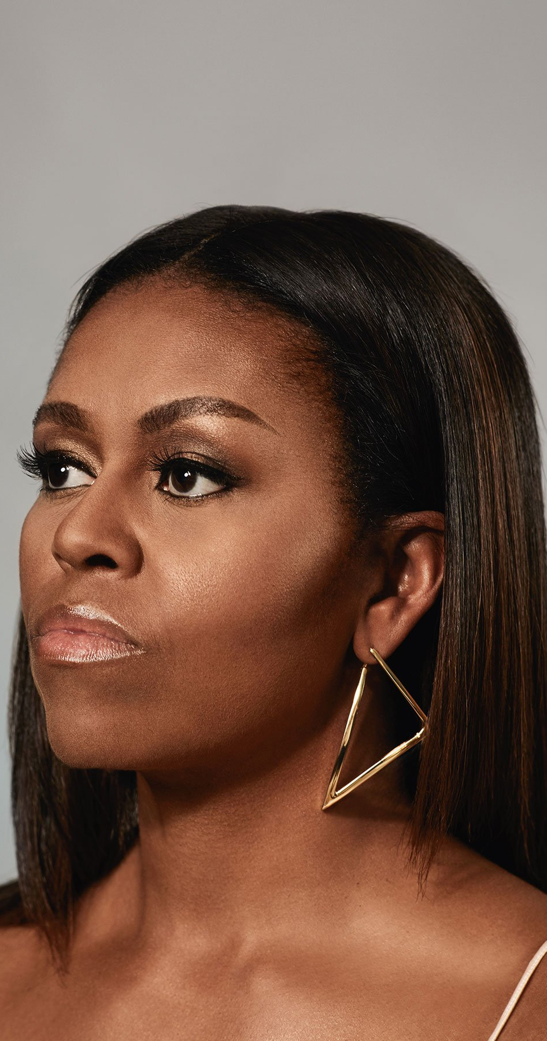
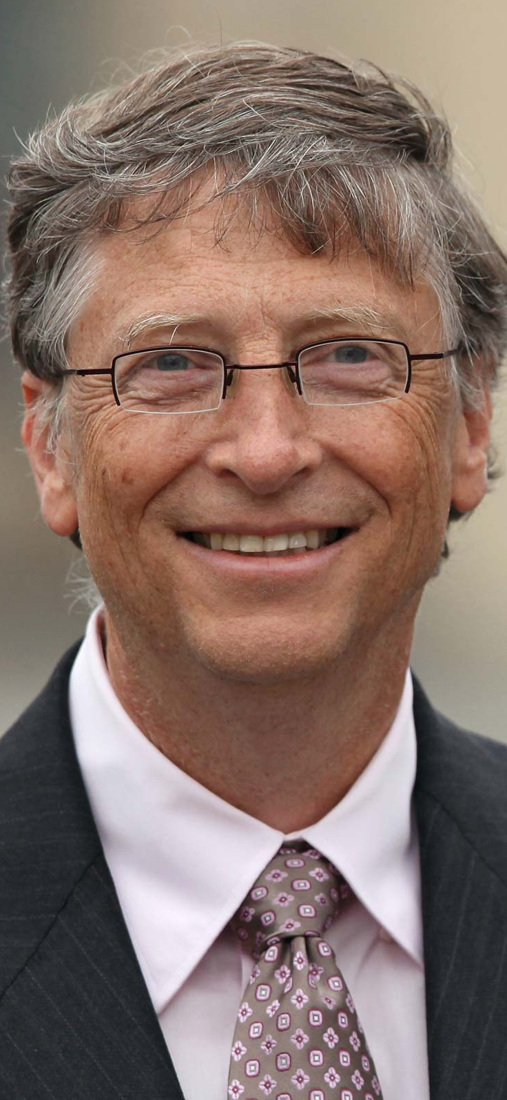
Notes:
Successful people are nothing alike accept that they understand what their unique voice is and uses this to drive their goals

Slide 4
"ALWAYS REMEMBER THAT YOUR ARE ABSOLUTELY UNIQUE, JUST LIKE EVERYONE ELSE"
Notes:
Everybody wants something different, which makes them unique
Understanding your unique values means you’re offering something to the world that nobody else can
Your unique value does not determine what job you do, but how you do it

Slide 5
THE ART OF
BEING YOURSELF
THERE'S SOMETHING SPECIAL ABOUT YOU
AND YOU KNOW IT!
BE YOURSELF, BE AUTHENTIC
YOUR UNIQUE VOICE, BELIEFS & VALUES
IS YOUR BRAND IDENTITY

Slide 6
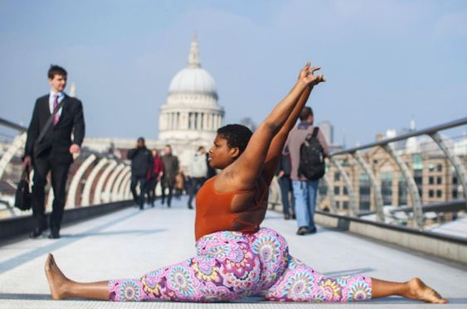
WHAT IS EASY FOR YOU
AND HARD FOR OTHERS?
Notes:
Can you think of the things that comes natural to you?
What do you find easy and fun?
What tends to be difficult or mysterious for others but obvious for you?

Slide 7
WHAT TOPIC DO PEOPLE ALWAYS WANT TO PICK YOUR BRAIN ABOUT?
WHAT IS IT I CAN'T STOP MEDDLING IN?
WHAT FRUSTRATES ME OR DRIVES ME CRAZY
WHEN I SEE IT BECAUSE I KNOW IT CAN BE SO MUCH BETTER, EASIER, MORE EFFICIENT etc.

Slide 8
TOP TIPS
EMPATHISING WITH
YOUR AUDIENCE
THE MAIN THING IS TO
STICK TO THE MAIN THING
ACT LIKE A HUMAN
MEASURE
Notes:
EMPATHISING WITH YOUR AUDIENCE
Make your audience know that you share the same values as them
Tap into a group of people you have shared interests with e.g. LGBT+ / Religious Groups / Sports etc.
Share your ideas in the places these people talk online e.g. Facebook groups / Webinars / Reddit
Create awareness around things that directly effects them
Build trust with your audience first, before trying to get them to take interest in what you’re trying to make them do
THE MAIN THING IS TO STICK TO THE MAIN THING
Focus on 1 or 2 key messages on what you’re trying to say
Don’t overcomplicate your message
Use visuals to make your message more digestible
ACT LIKE A HUMAN
Respond to people interacting with you online in real-time
Self-Care: block people or disable comments for your own wellbeing
Watch the Social Dilemma on Netflix

Slide 9
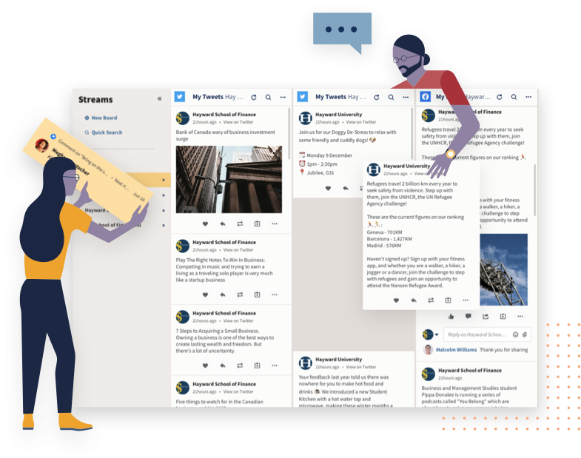
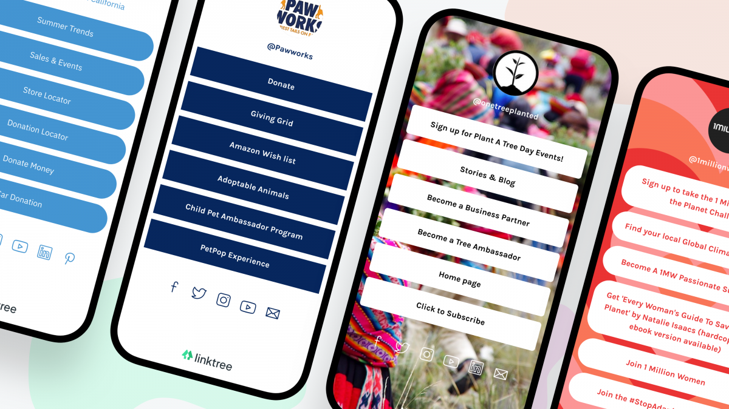
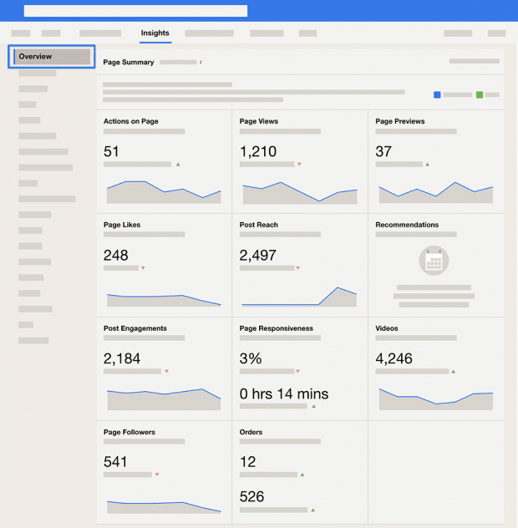
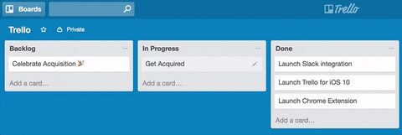
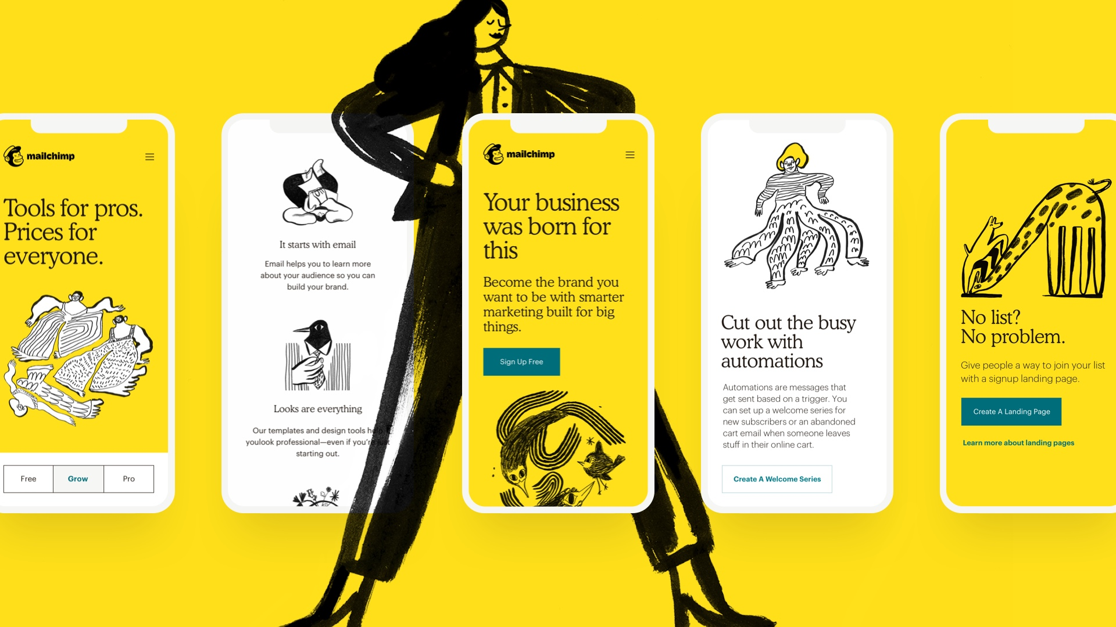
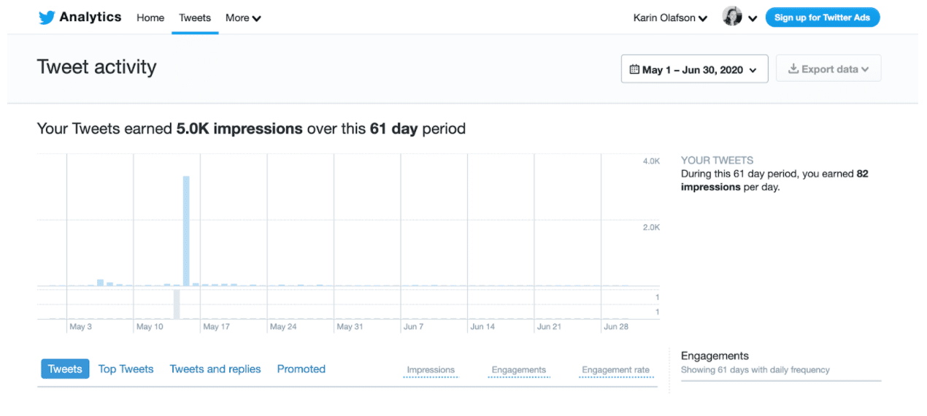
FREE TOOLS
HOOTSUITE
LINKTREE
TRELLO
SOCIAL MEDIA ANALYTICS
MAILCHIMP
Notes:
HOOTSUITE: https://hootsuite.com/en-gb/
LINKTREE: https://linktr.ee/
TRELLO: https://trello.com/
SOCIAL MEDIA ANALYTICS
www.analytics.twitter.com
www.analytics.facebook.com
Instagram analytics is built in the app’s settings
MAILCHIMP: https://mailchimp.com/

Slide 10
QUESTIONS?
CAMELIA 👉 C.PURWANTO@MDX.AC.UK

