Slide 1
Liberation and Allyship
Please introduce yourself in the chat with your names and pronouns
What are Liberation Groups?
How can we be good allies at Middlesex?
What is an ally?

Slide 2
Introductions Reygan - Student Groups Coordinator Pronouns: She/Her

Slide 3
House Keeping
Please make sure you are muted when others are speaking
This is a safe, non-judgmental space
This session is being recorded so that it can be used as a resource for future sessions.
Raise your hand or message the chat if you have a question

Slide 4
What are Liberation Groups?
Liberation groups are support networks for students who face discrimination and under-representation in their day-to-day lives
They meet regularly to share experiences and common struggles that they face, to socialise and support each other, and to plan campaigns and educational workshops
All liberation groups are led by students who identify into that group

Slide 5
MDXSU Black Students group represents and makes changes for students of African, Arab, Asian and Caribbean heritage.

Slide 6
The MDXSU Disabled Students group defends the rights and represents the interest of disabled students at Middlesex University.
Any student who self-identifies as having a disability, including students with specific learning difficulties, such as dyslexia or dyspraxia, or students with long-term health conditions are welcome to join.

Slide 7
The MDXSU Women Students group works to represent and campaign for change for women both on campus and nationally.
Any student that self-identifies as a woman can join the group and help shape the work that we do.

Slide 8
The MDXSU LGBT group is open to any students who self-identifies as part of the LGBTQ+ community.
The group provides a space for meeting other people, sharing experiences and creating change on campus.

Slide 9
Intersectionality
'The better we understand how identities and power work together from one context to another, the less likely our movements for change are to fracture' (Kimberle Crenshaw 1989)
Understanding the ways in which people experience different levels of privilege according to their identies (aka race, class, gender) allows us to not only support others' better, but gain more indepth knowledge of how people are discriminated against in societal life.

Slide 10
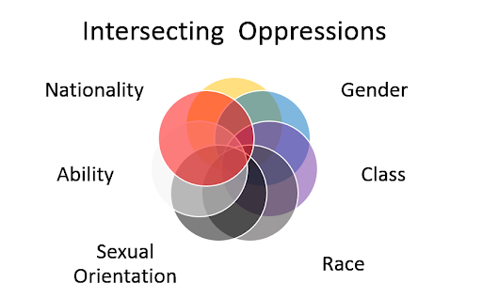
Intersectionality
Notes:
Explain the intersections (people have one or more identities etc). Give an example of why one person may face more oppression than another (a black LGBT person may face more difficulties in life because of the way they are percieved according to their race, AND their sexuality.
Say how the title of this diagram (oppressions) isn't helpful, and essentialises the point of the theory. Intersectionality itself is a lens through which we can look at the dynamics of power within society, and how power affects different people's lives etc white straight men have more power according to social status than black men do.
It is important that we recognise intersectionality when we think about how we can support eachother- by recoginising our differences we are able to look at our privilege, and enable groups to take up space. We can also identify obstacles that some people might face, so that we can provide our assistance to others by supporting the work they do, and by recognising their needs.

Slide 11
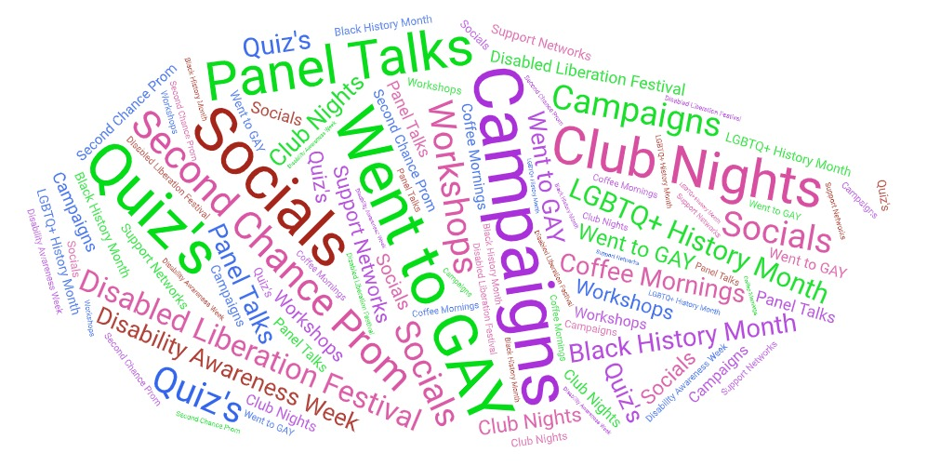
What have the Liberation Groups been up to this year?

Slide 12
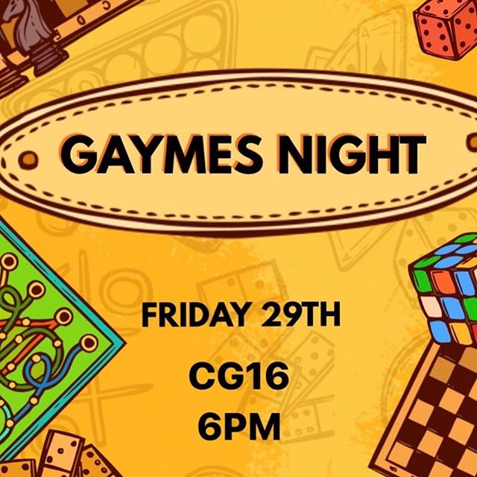
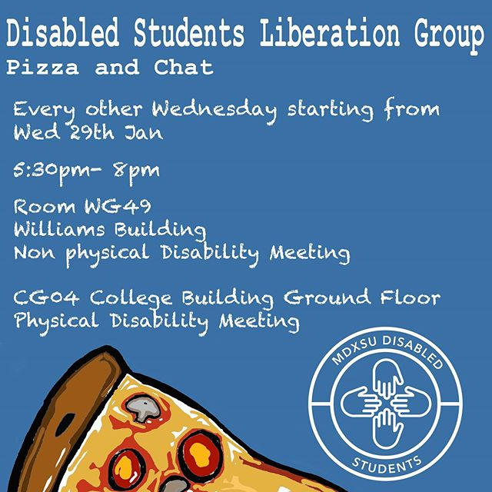

Slide 13
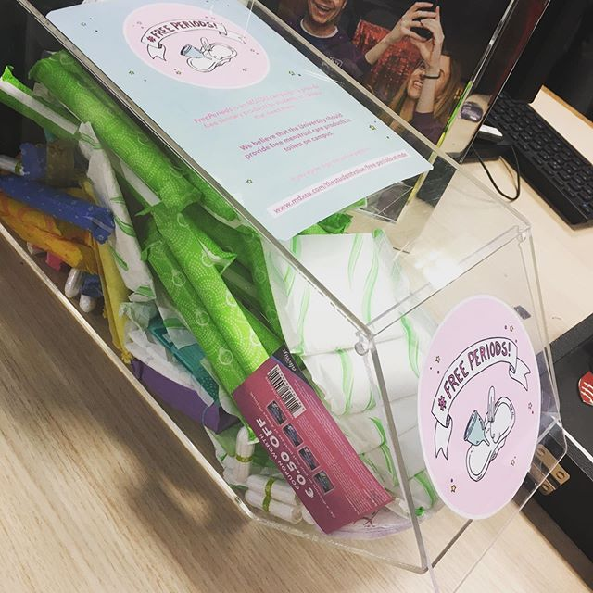
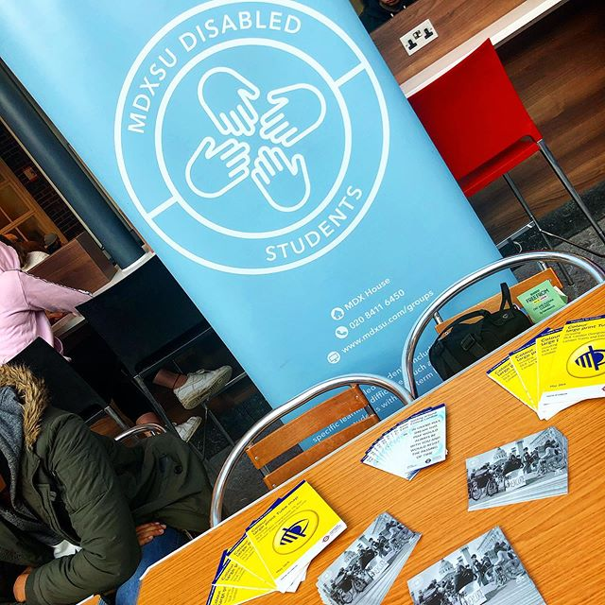
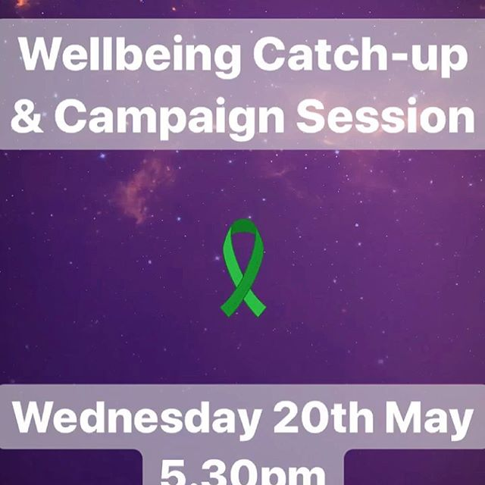

Slide 14
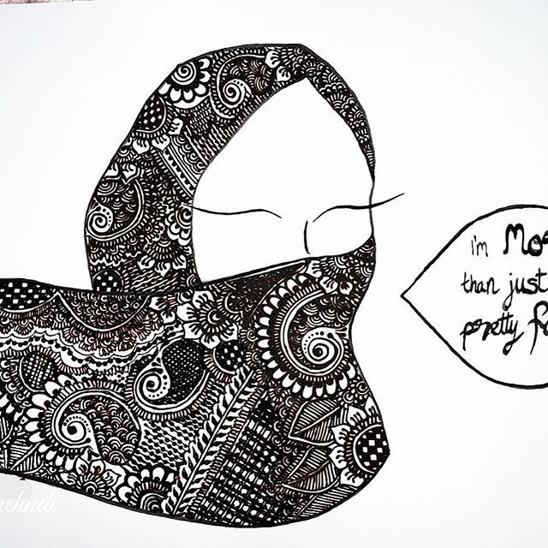

Slide 15
So...how can you join our Liberation Groups, and hear about what they're up to next?
https://www.mdxsu.com/student-groups
https://www.mdxsu.com/liberations
https://www.mdxsu.com/mdxsu-events

Slide 16
Liberation Group Socials
mdx_womens_lib
mdxdisabledstudents
mdxsublackstudents
mdx_lgbtq
mdxsu_societies
MDXSU Disabled Students
MDXSU Women Students
MDXSU Black Students
MDXSU LGBT Students
r.davison@mdx.ac.uk
societies@mdx.ac.uk
@mdxsu_societies

Slide 17
Task 1- What is an ally?
www.menti.com code 66 06 75 4
Notes:
Menti task – what is an ally?

Slide 18
Allyship
Someone who supports a cause
Provides physical and mental assistance to groups of people in society that they don't identify with personally
A friend

Slide 19
Task 2- What makes a good ally?
www.menti.com 66 06 75 4
Notes:
Menti task – what makes a good ally?

Slide 20
Do's & Don'ts of being an ally
Do's
Hold yourself accountable for your actions
Correct yourself if you make a mistake
Read up
Donate (time, resources, money) to causes if you are able to
Educate those around you who share your privilege
Don'ts
Think you know how 'allyship' is best done
Over-explain others' identities and problems to them even if you are trying to show your understanding
Be a performative activist- do things when you say you will do them
Be a non-active bystander

Slide 21
Being an ally at MDX
Follow Liberation and society groups on social media
Share their posts (and read up on what the conversation is about)
Colloborate with Liberation groups on student lead events to increase acccessibility
Share resources and helpful information to others who may need it
Educate your society/group members on particular issues so that everyone can be better allies
Notes:
Sharing liberation group posts, sharing resources, collobrating with lib groups on events

Slide 22
What will you do to be a good ally?
www.menti.com 38 17 17 4
Notes:
Menti task – what will you do to be a good ally

Slide 23
To find out more, visit www.mdxsu.com Get in touch any time to ask us any questions

